Slide 1



Enhanced intrusion detection system with deep learning
Mohab Sameh Ibrahim Abdel-Wahab
ID: 180879
Supervised by: Dr. Ayman Ezzat, Eng. Ahmed Neil
31, Oct 2020

Slide 2
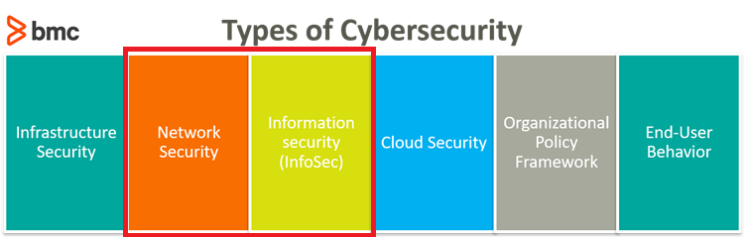
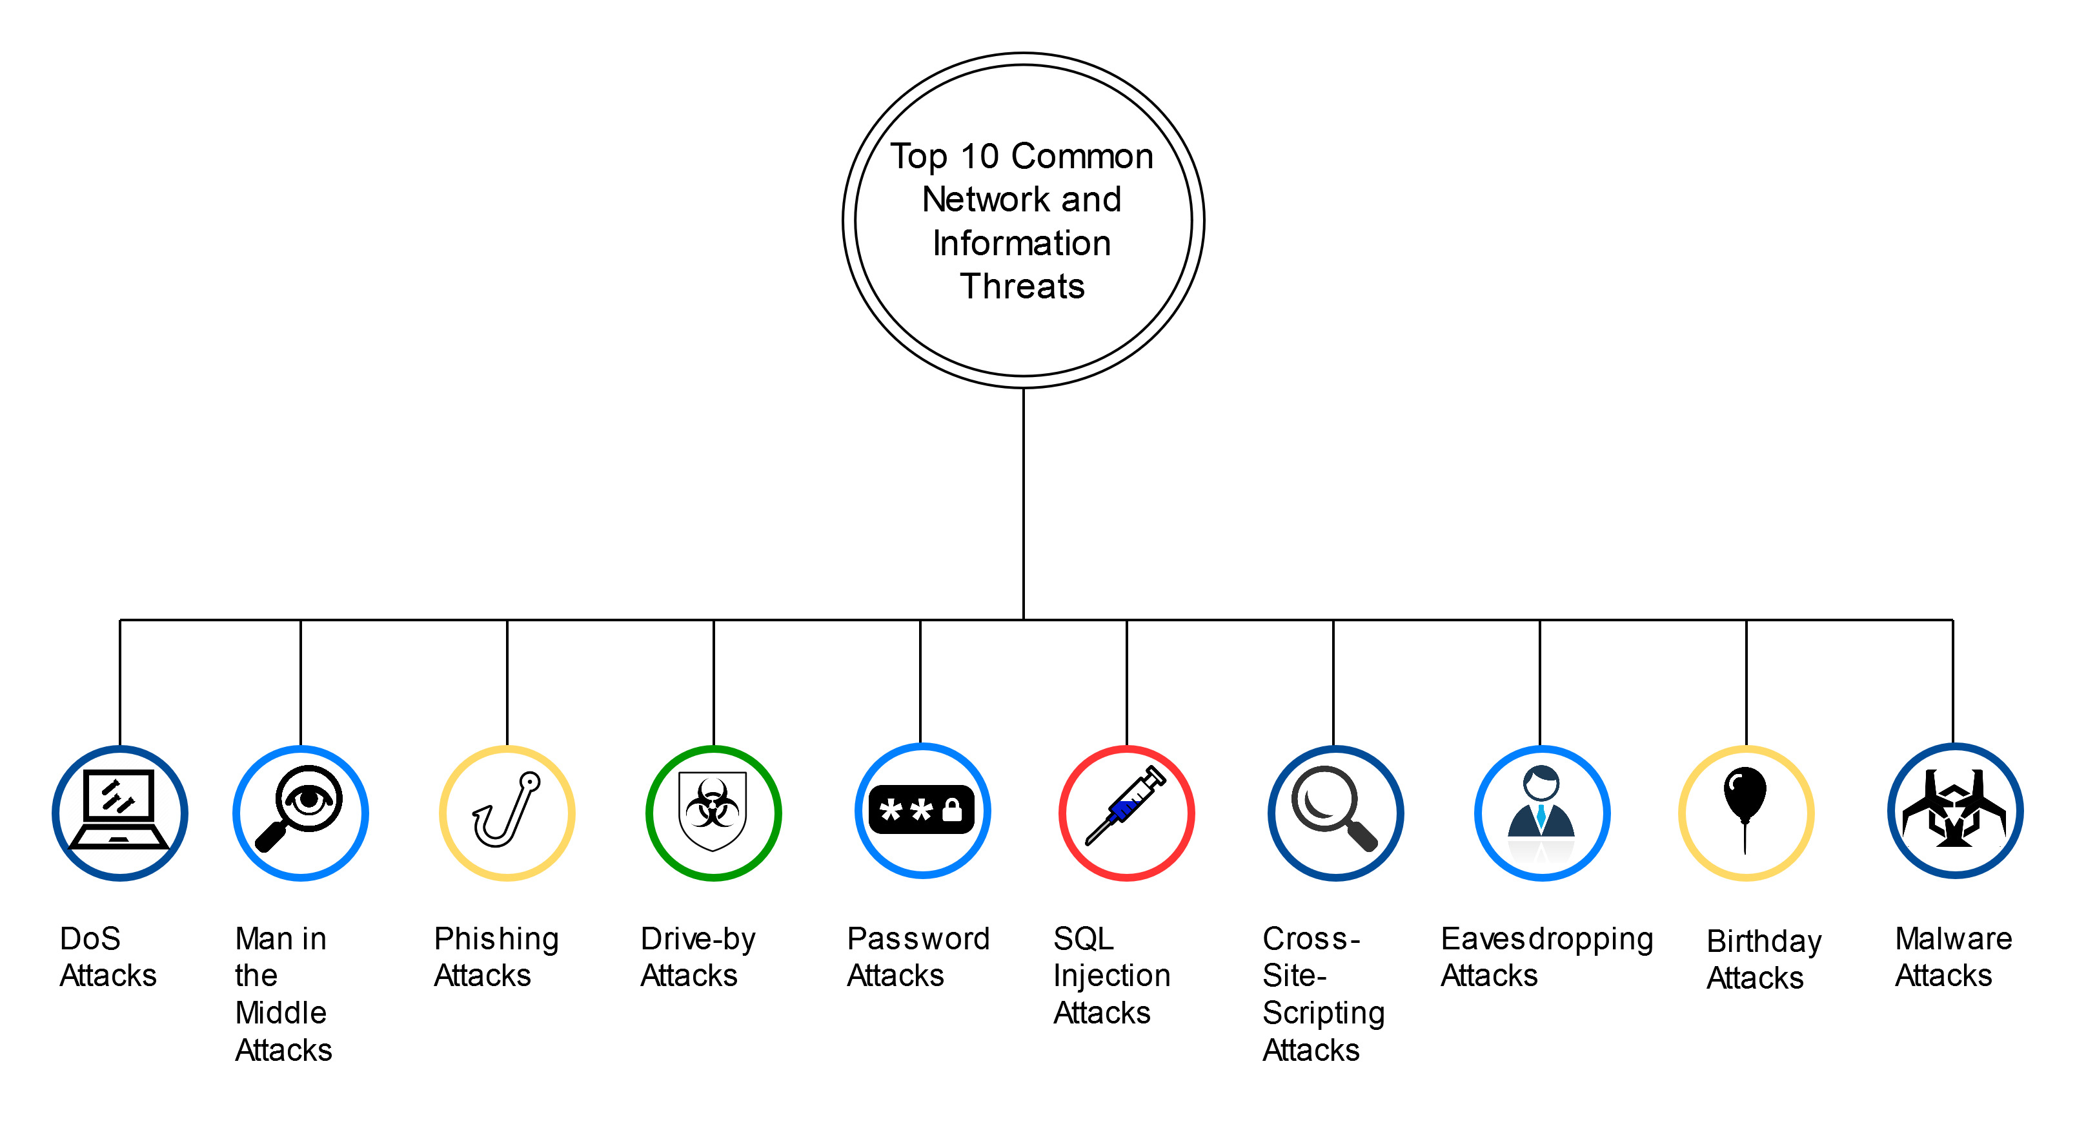
Intro (1/2)
Cybersecurity -> Defending Computers, mobile devices, etc. from malicious attacks.
Potential Network & Information Threats

Slide 3
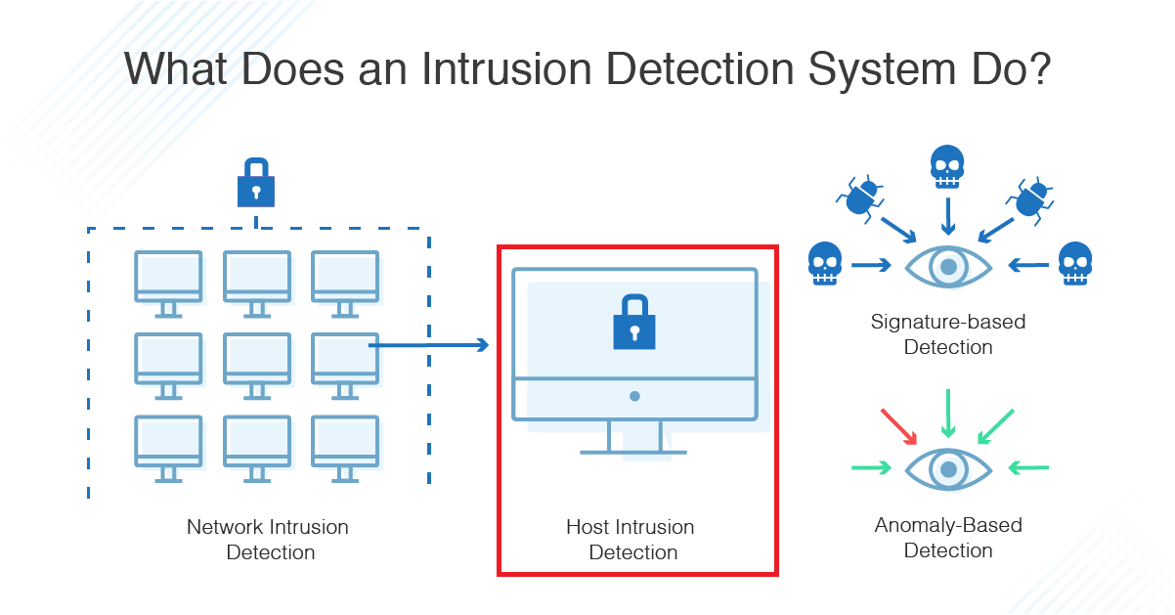
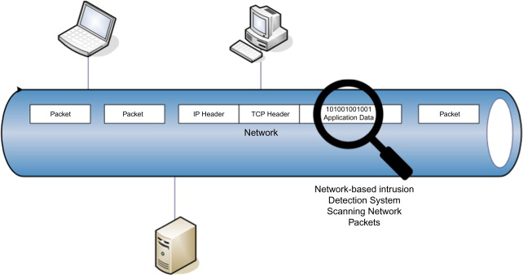
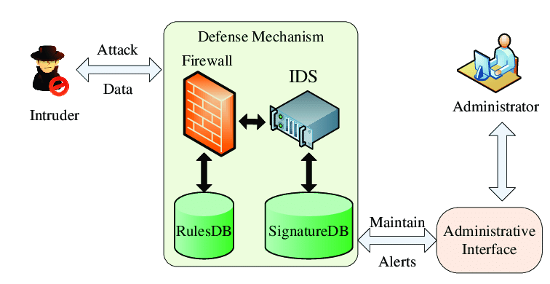
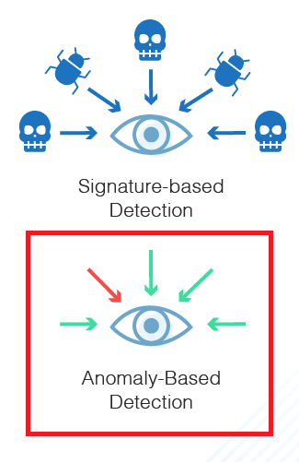
Intrusion Detection Systems
Intro (1/2) cont.
Intrusion Detection Systems (IDS):
Network IDS (NIDS)
Host IDS (HIDS)
Two types:
Signature-Based
Anomaly-Based

Slide 4



Anomaly-Based IDS
Intro (2/2)
IDS + Deep Learning = Anomaly-Based IDS
Challenges:
Enhancing real-life datasets
Applying more accurate Hybrid Deep Learning Methods
High Network Traffic
Client-Sided Machine Learning IDS for Mobile Devices
Malicious attacks are constantly changing

Slide 5
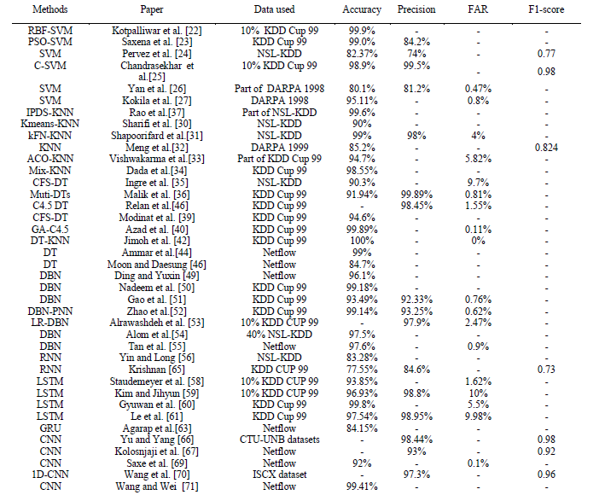
Machine Learning and Deep Learning Methods for Cybersecurity
Related Work (1/2)
A comparative study of the used ML and DL methods in IDS.
Dataset | Classes | Sub Classes
KDD - 99 | 5 | 22
NSL KDD | 5 | 22
DARPA 1998 | 5 | 22
ISCX | 9 | 14

Slide 6
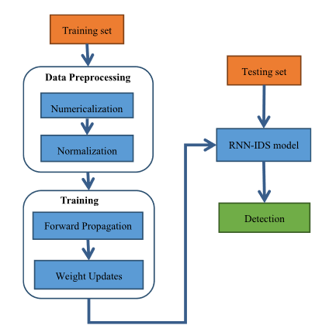
A Deep Learning Approach for Intrusion Detection Using Recurrent Neural Networks
Related Work (2/2)
Method used: Recurrent Neural Networks (RNN)
Dataset: NSL-KDD
Detection of the 5 classes
Accuracy: 97.09%
Offline Detection

Slide 7


Problem Statement
Lack of an enhanced Hybrid Deep Learning Intrusion Detection System with enhanced accuracy and enhanced datasets.

Slide 8
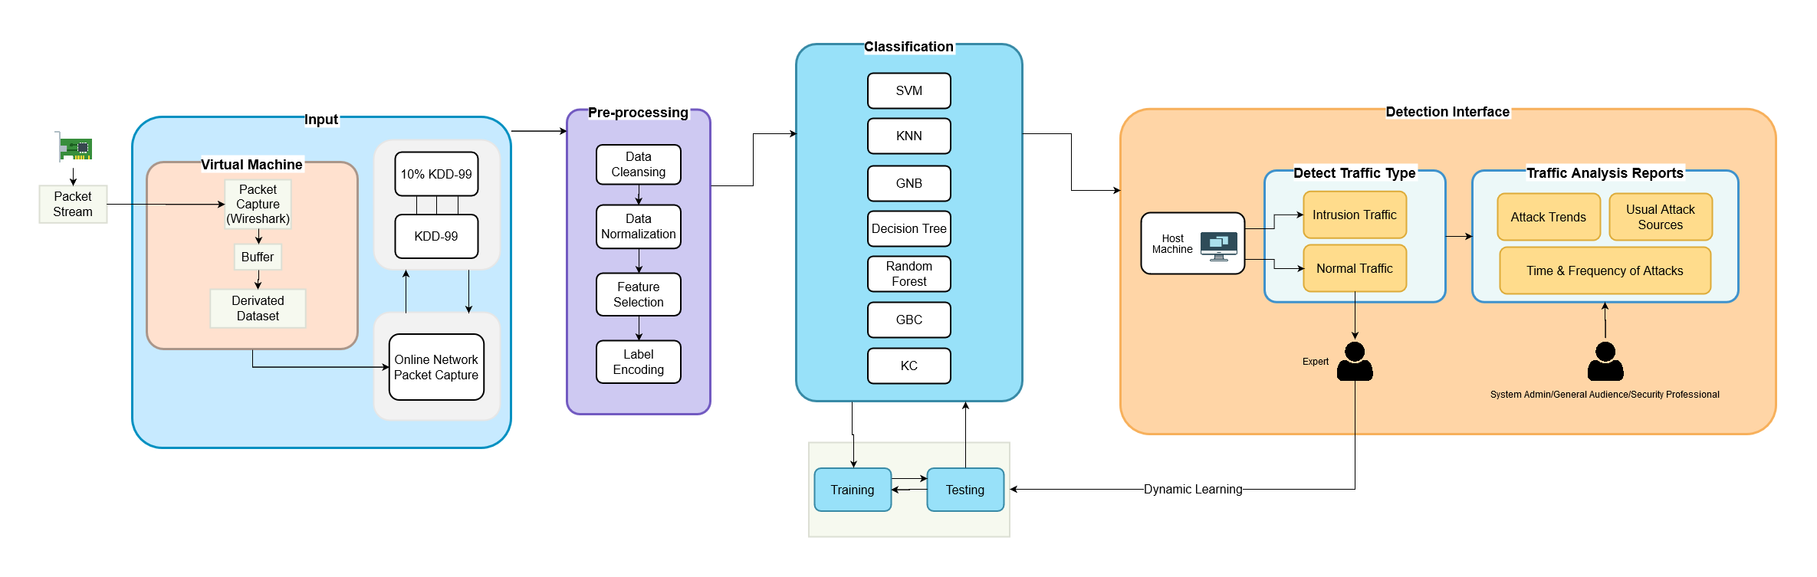
System Overview

Slide 9
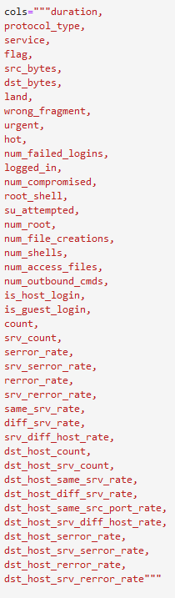
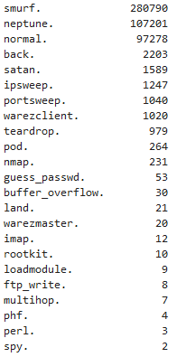
Input
KDD-99 Dataset:
Real-life network packets
Most widely used dataset
41 features
4.9 million packets
Features:
Attack Types & Frequency:

Slide 10
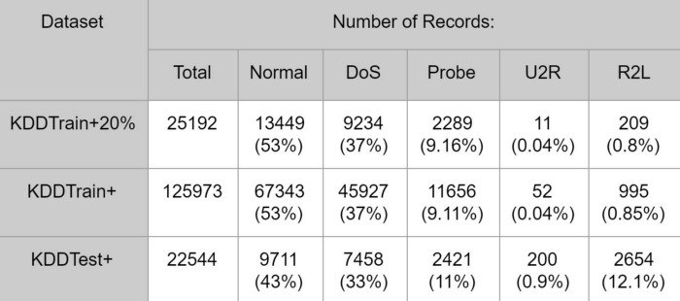
Input
NSL-KDD Dataset:
Iteration of the KDD-99
Tries to solve kdd-99 problems
No redundant records
Features:
Attack Types & Frequency:

Slide 11
Pre-processing
Data Extraction: KDD-99 is a public dataset (http://kdd.ics.uci.edu/databases/kddcup99/kddcup99.html)
Cleansing null packets
Normalization of Highly-Variant Data
Feature Selection
Label Encoding of Categorical Features
Visualization & data correlation

Slide 12
Input (cont.):
Previous work has followed similar methods in pre-processing of data:
Numericalization of categorical data (label/one-hot encoding)
Normalization of highly variant data (logarithmic scaling)

Slide 13
Classification
K-Nearest Neighbor Classifier
Random Forest
SVM
LSTM

Slide 14
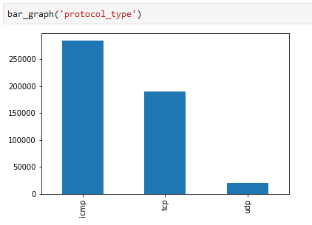
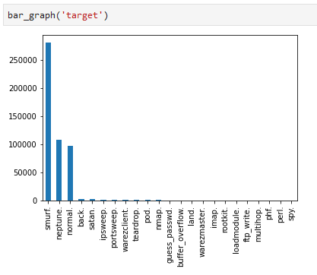
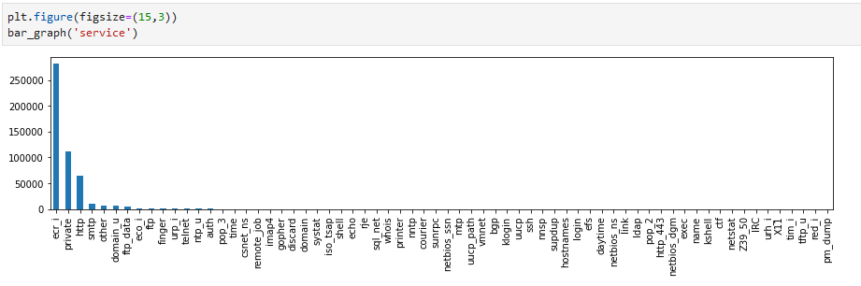
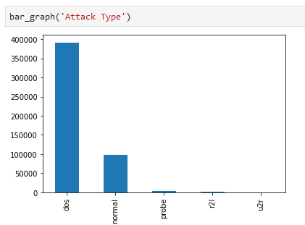
Pre-Experiment
Pre-processing:
Visualizations
Numericalization (Label Encoding) of 3 categorical features

Slide 15
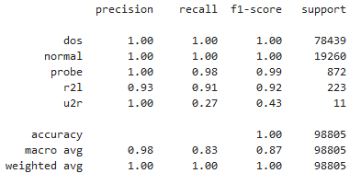

Pre-Experiment
K-Nearest Neighbors:
Used 0.33 Test-to-Train ratio
3 Nearest Neighbors
10% of KDD-99 Dataset
Training Time: 139 seconds
Testing Time: 281 seconds
Accuracy: 99.9%

Slide 16
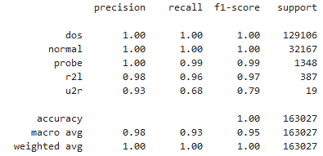

Pre-Experiment
Random Forest
Used 0.33 Test-to-Train ratio
30 Estimators
10% of KDD-99 Dataset
Training Time: 7.11 seconds
Testing Time: 0.39 seconds
Accuracy: 99.9%

Slide 17
User Interface:
The users of the system can be multi-levels:
General Audience Individuals
System Administrators
Defensive/Testing Security Professionals
Governmental Agencies taking security measures
Interface shall preview reports including:
Normal/Attack packets
Type of attack in packet
Time and frequency of attacks
Trends in attack frequency
Usual attack sources

Slide 18



Expected Contribution
Comparative Study - Submitted to ICCES 2020 (Under Review)
Online Prediction Intrusion Detection System
Providing a suitable dataset for real-world IDS application

Slide 19
Appendix

Slide 20
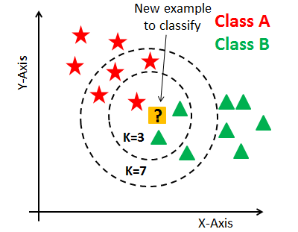
K-Nearest Neighbor Classifier
Supervised learning model
Uses k-closest training samples in feature space
Known as Lazy Learning model

Slide 21
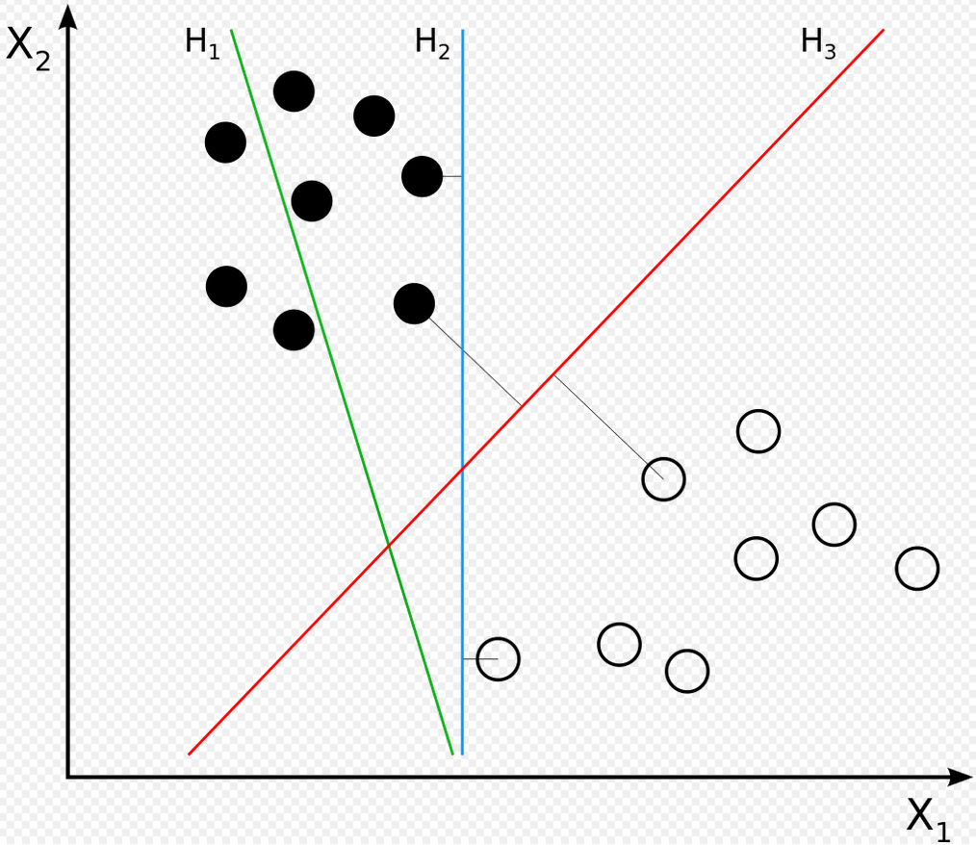
Support Vector Machines (SVM)
Supervised learning model
Creates a separating margin for classification
New data is classified based on whether it exceeds the determined threshold margin

Slide 22
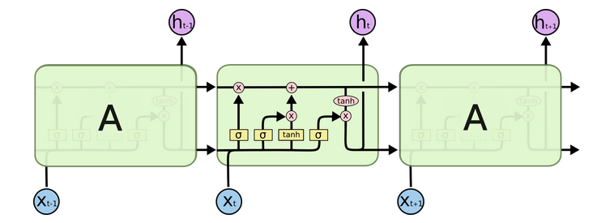
Long Short-term Memory
A type of Recurrent Neural Network
Short-term memory learns short chains of data recurrently
Uses Long memory to store learned relevant information

Slide 23
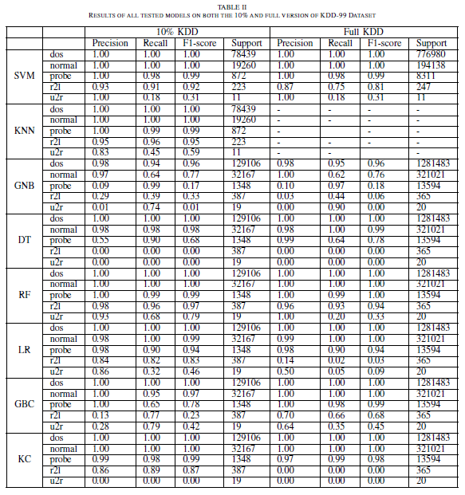

Slide 24
Draft slide (this slide is hidden in presentation view)
Provide a system that uses:
Best accuracy ML method + 1 Dataset
Hybrid ML (2 methods) + 1 Dataset
Hybrid ML (2 methods) + 2 Datasets
Online Prediction Intrusion Detection System
Hybrid ML Solution on Mobile Devices

